Slide 1
COS 30049 Computing Technology Innovation Project
Week5: Data Pre-Processing in Machine Learning
Lecture1
Hao Zhang
Semester 2

Slide 2
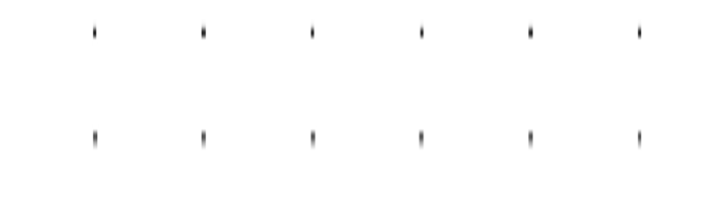

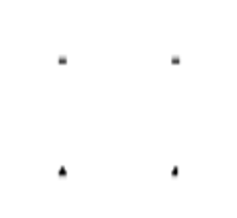

Acknowledgement of Country
We respectfully acknowledge the Wurundjeri People of the Kulin Nation, who are the Traditional Owners of the land on which Swinburne’s Australian campuses are located in Melbourne’s east and outer-east, and pay our respect to their Elders past, present and emerging.
We are honoured to recognise our connection to Wurundjeri Country, history, culture, and spirituality through these locations, and strive to ensure that we operate in a manner that respects and honours the Elders and Ancestors of these lands.
We also respectfully acknowledge Swinburne’s Aboriginal and Torres Strait Islander staff, students, alumni, partners and visitors.
We also acknowledge and respect the Traditional Owners of lands across Australia, their Elders, Ancestors, cultures, and heritage, and recognise the continuing sovereignties of all Aboriginal and Torres Strait Islander Nations.

Slide 3
Objectives: 1. Recap: Data sources and the details of data processing 2. Data processing: Data transformation 3. Learning basic data analysis - visualize your data

Slide 4
Recap
Data processing is a broad concept that involves performing various operations on data to extract useful information. These operations include, but are not limited to:
Data Collection: Gathering raw data from various sources.
Data Cleaning: Removing or correcting errors, missing values, or inconsistent data.
Data Transformation: Converting data from one format or structure to another.
Data Reduction: Reducing the volume of data through aggregation or filtering while retaining important information.
Data Analysis: Applying statistical methods and algorithms to analyze data and derive conclusions or identify patterns.
Already Learnt on Week 4
Delve into deeper

Slide 5
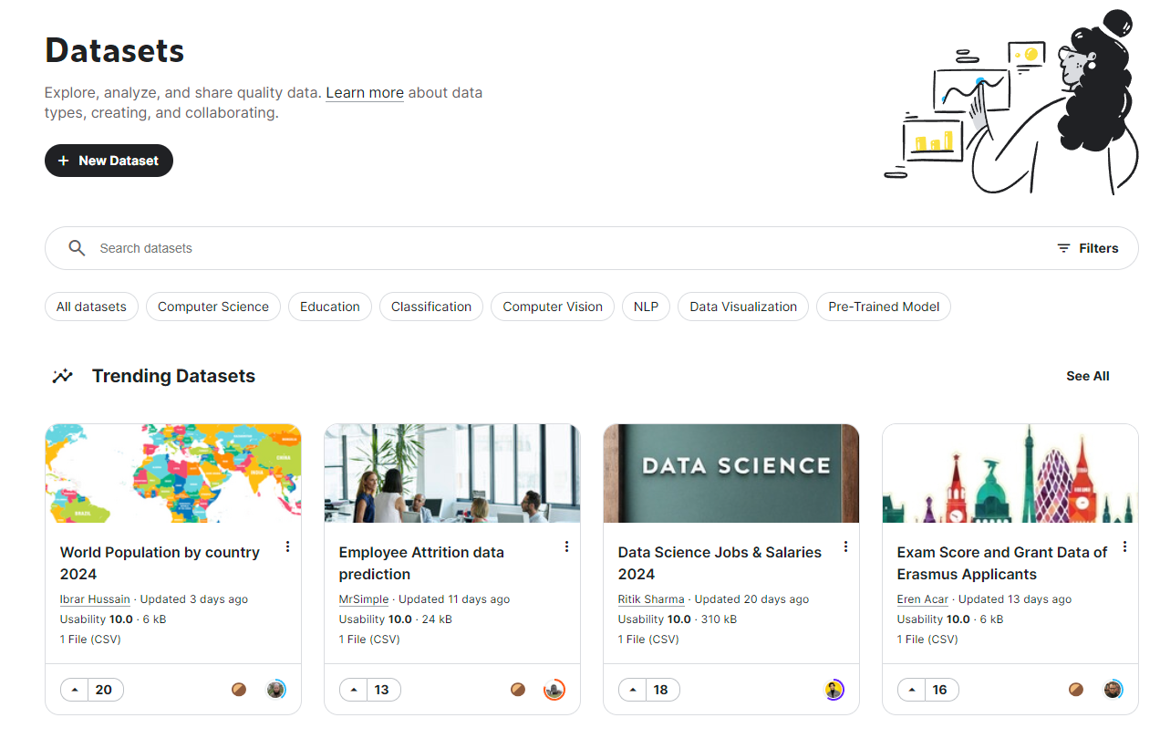
1. Kaggle - good open-source data sharing platform
Data Sources:
https://kaggle.com/

Slide 6
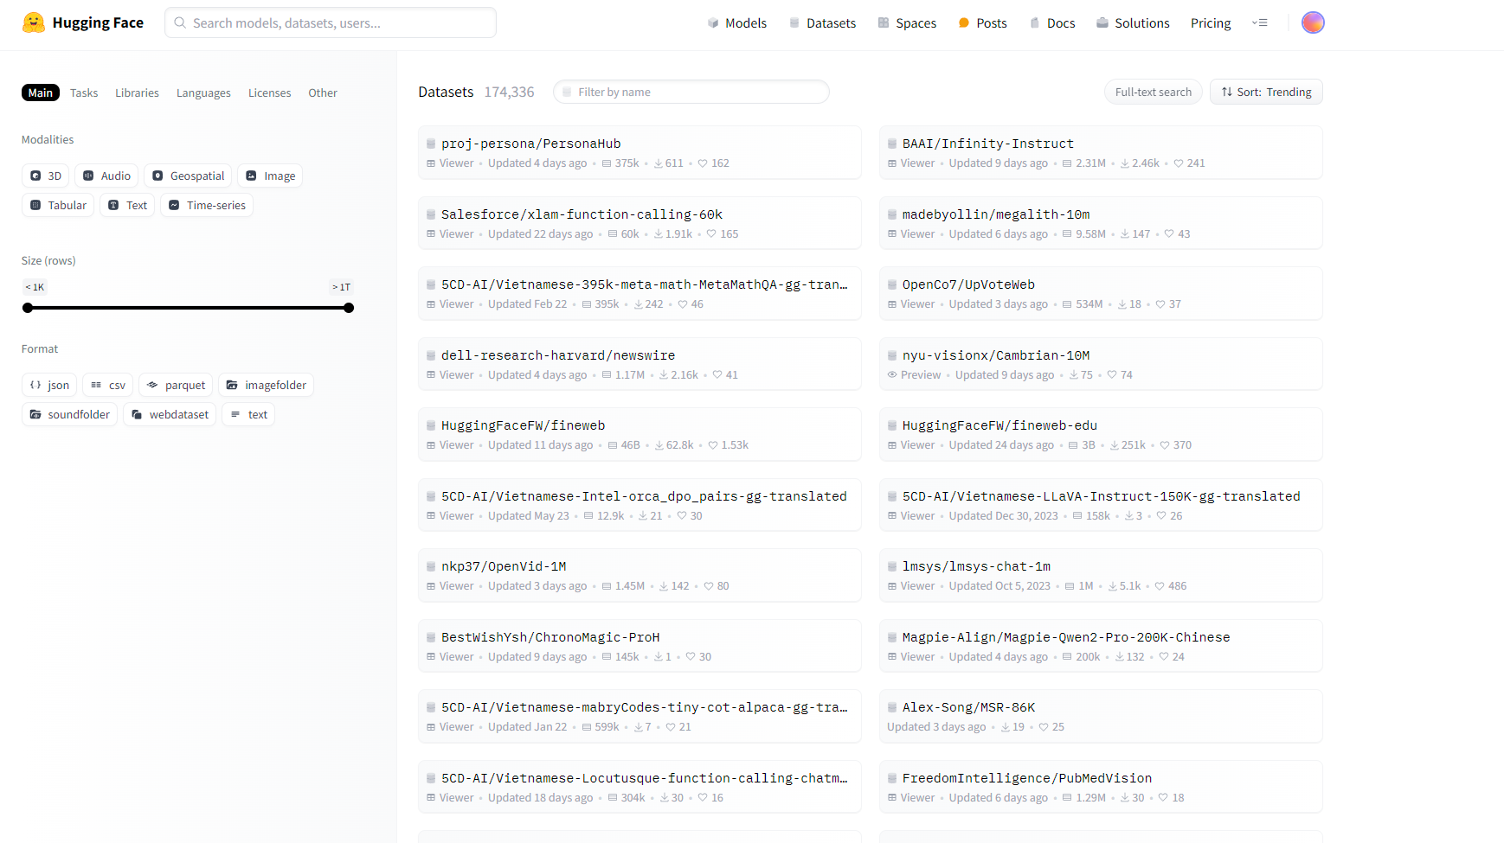
2. Huggingface - Very good open-source data sharing platform
Data Sources:
https://huggingface.co/
But much data here is about Large Language Models

Slide 7
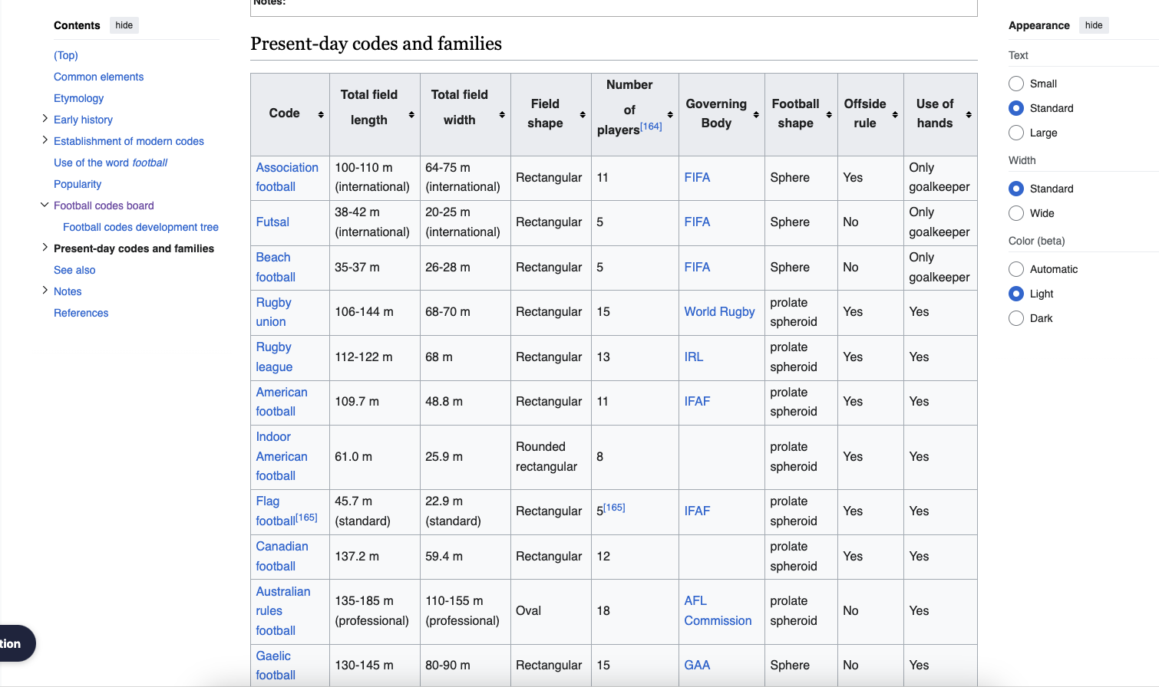
3. Wikipedia - also have some interesting data
Data Sources:
https://en.wikipedia.org/
There are many data tables in some pages of Wikipedia, which may help you on your project.
Wiki also has a separate data website
https://www.wikidata.org/

Slide 8
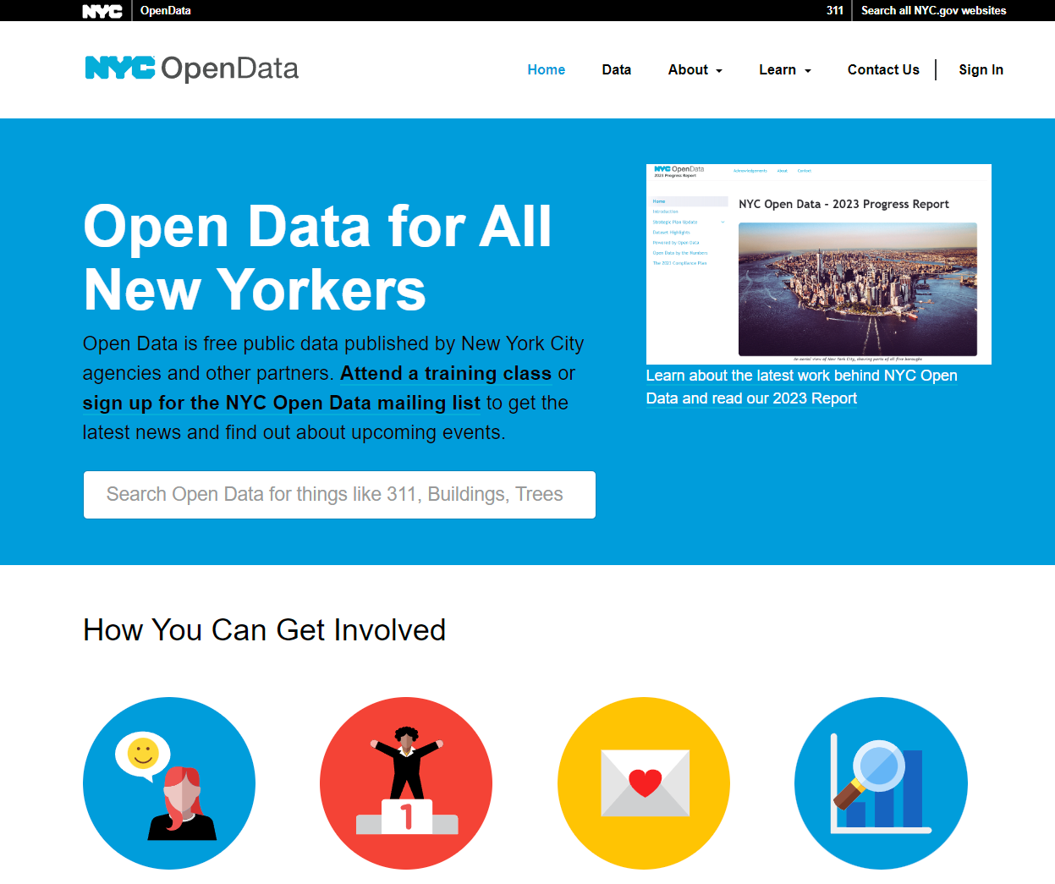
4. Other Government Open-source Data – NYC Data
Data Sources:
Other examples include:
Australian Government Data
Victoria Government Data
Australian Bureau of Statistics
Closing the Gap Information Repository

Slide 9
5. Common Open-Source Dataset Licenses
Data Sources:
MIT License
- Permissive: Allows almost any use, including commercial
- Requirement: Include original copyright and license notice
Apache License 2.0
- Permissive: Allows commercial use and modification
- Requirement: Document changes, includes patent grant
GNU GPL
- Copyleft: Requires derivative works to be GPL-licensed
- Requirement: Strong open-source requirement
Creative Commons (CC)
- Flexible: Multiple options (e.g., CC0, CC BY)
- Requirement: Customizable terms, often attribution
Open Data Commons (ODC)
- Specialized: Designed for datasets (e.g., ODC-BY, ODbL)
- Requirement: Attribution, sharing under similar terms
For the assignment, students aiming for an HD should utilize additional datasets and refer to these Licenses.

Slide 10
Data Processing
In the realm of machine learning, data is the foundation on which models are built. However, raw data is often messy, inconsistent, and spread across various sources. This is where the Extract-Transform-Load (ETL) pipeline becomes crucial. ETL is a process that helps in systematically preparing data for analysis and modelling.
Extract: The first step is extracting data from various sources, such as databases, spreadsheets, or APIs. This data may come in different formats and from multiple origins, requiring careful extraction to ensure no valuable information is lost.
Transform: Once the data is extracted, it undergoes transformation. This step involves cleaning, normalizing, and transforming the data into a consistent format suitable for analysis. This might include handling missing values, converting data types, aggregating data, or performing feature engineering.
Load: The final step is loading the transformed data into a storage system or directly into a machine learning model for further analysis. The prepared data is now ready to be used for training models, making predictions, or driving insights.
The ETL pipeline is essential in ensuring that the data used in machine learning is of high quality, which in turn leads to more accurate and reliable models.

Slide 11
Data Processing
When working with data, whether for analytics or data science applications, a key step in the Extract-Transform-Load (ETL) pipeline is data transformation
Manipulate the form of the data – For example: Reordering and selecting rows; renaming and selecting columns; removing duplicate values
Engineer features in the data – For example Creating new variables for analyzing
Transform data values - Creating a distribution appropriate for analysis

Slide 12
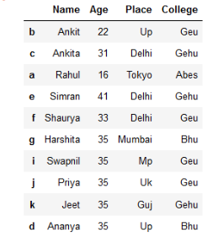
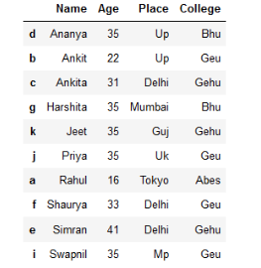
Data Transformation: Manipulate the form of the data
1. Sorting based on name
The table on the left is sorted by the "Name" column, and the result is shown in the table on the right. After sorting, the names are arranged in alphabetical order, with "Ananya" appearing at the top and the other names following alphabetically.
Sorting data helps in easier searching, analysis, and understanding. By organizing data based on a specific column, patterns, trends, or specific entries can be quickly identified, improving data management efficiency and readability.

Slide 13
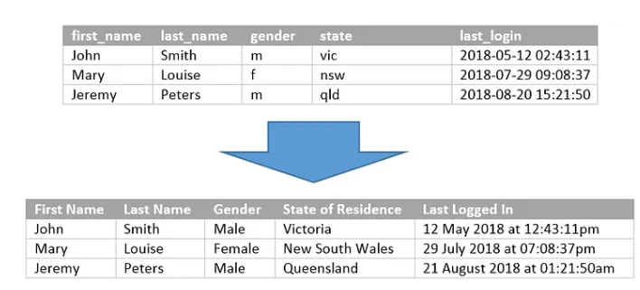
Data Transformation: Manipulate the form of the data
Value Redefinition
This image shows a transformation of a data table, where the original data (top) is formatted and expanded to be more readable and user-friendly (bottom).
The column headers are renamed to be more descriptive (e.g., "state" to "State of Residence").
Values are formatted, such as converting state abbreviations to full names and changing the "last_login" timestamp into a more readable date-time format.
This enhances data clarity, making it easier to interpret, analyze, and present, especially for non-technical audiences.

Slide 14
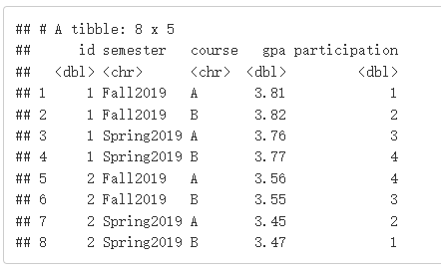
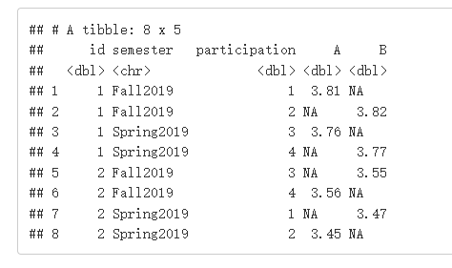
Data Transformation: Reshaping Your Table
Long format to Wide Format
This image shows the transformation of a data table from a long format (top) to a wide format (bottom).
The original table has columns for id, semester, course, gpa, and participation.
In the transformed table, the course column is spread into two separate columns (A and B), each containing the corresponding gpa values. The participation column remains.
This operation, known as "pivoting," is useful for restructuring data to facilitate analysis, making it easier to compare the gpa of different courses side by side.

Slide 15
Data Transformation: Add New Variable
Common example of creating a new variable is when a dataset contains birthdates. A more useful feature might be “age” rather than using the raw birthdate.
birthdates
01/11/1994
03/11/1994
02/03/1998
12/03/2000
...
...
...
Age
30
30
36
34
...
...
...

Slide 16
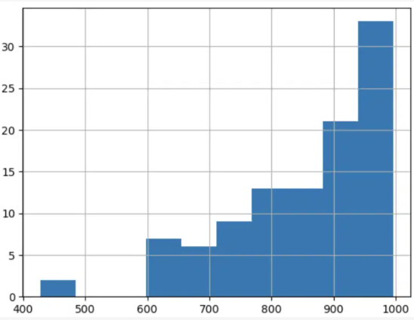
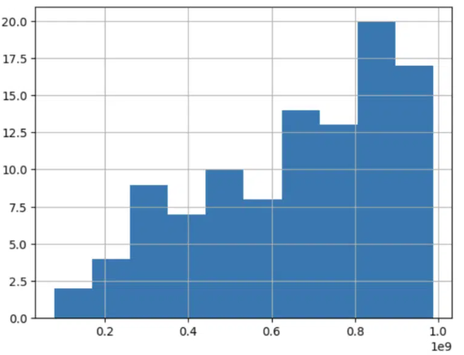
Data processing: Transform Data Values
Distribution transforms
Adjust data distributions to align with model assumptions, enhance performance, and reveal clearer patterns.
Normalization: Scale the data to a specific range, typically [0, 1] or [-1, 1], making it easier for models to learn and converge.
Standardization: Adjust data to have a mean of 0 and a standard deviation of 1.
Example:
If square footage is measured in thousands while lot size is in hundreds, the model coefficients could become biased towards the feature with the larger scale. Normalizing these features helps in achieving a more balanced and interpretable model.
If you're building a linear regression model to predict a patient's risk score based on age, blood pressure, and cholesterol levels, standardizing ensures each feature contributes equally, enhancing accuracy and interpretability.

Slide 17
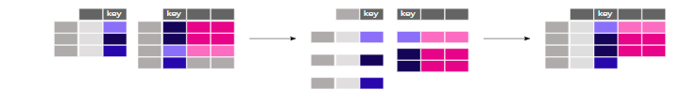
Data Transformation: Combine the Table
Joining tables using a common identifier (or key).
Operation:
The two separate tables on the left have a shared column labeled "key".
The operation joins these tables based on the matching "key" values.
The result is a combined table where rows from both tables that share the same key are merged.
Example: Suppose you have a table of students with student_id as the key and another table with exam scores also using student_id. By joining these tables on student_id, you can combine student details with their corresponding scores into a single table.

Slide 18
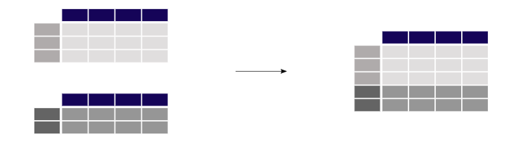
Data Transformation: Combine the Table
Concatenating Objects
Operation:
Two separate tables (on the left) are stacked on top of each other to form a single, larger table (on the right).
This operation simply appends rows from one table to another without altering the original structure.
Example: If you have two datasets of sales records from different regions, concatenating these datasets would combine them into a single dataset, allowing for consolidated analysis of all regions together.

Slide 19
Data Visualization
Why we need data visualization?
Visualizing your data is essential because it allows you to understand complex datasets more easily, identify patterns, trends, and outliers that might not be apparent in raw data, and communicate insights effectively to others.
It can reveal relationships between variables, support decision-making, and make data-driven conclusions more intuitive.
Additionally, visualizations help in summarizing large amounts of data in a concise and digestible format, making it easier for both technical and non-technical audiences to grasp the underlying information.

Slide 20
Data Visualization
Data visualization in Machine Learning
visualizing your data is crucial both before and after deploying machine learning algorithms.
Before Deployment: Visualization helps in understanding the dataset, identifying patterns, trends, and outliers, and ensuring data quality. It aids in feature selection, understanding correlations, and deciding on preprocessing steps.
After Deployment: Visualization allows you to assess the performance of the model, understand predictions, interpret model behavior, and communicate results. It helps in monitoring the model's effectiveness over time, identifying any issues, and making necessary adjustments.
Data visualization can help you find good machine learning model and help you evaluate after that.

Slide 21
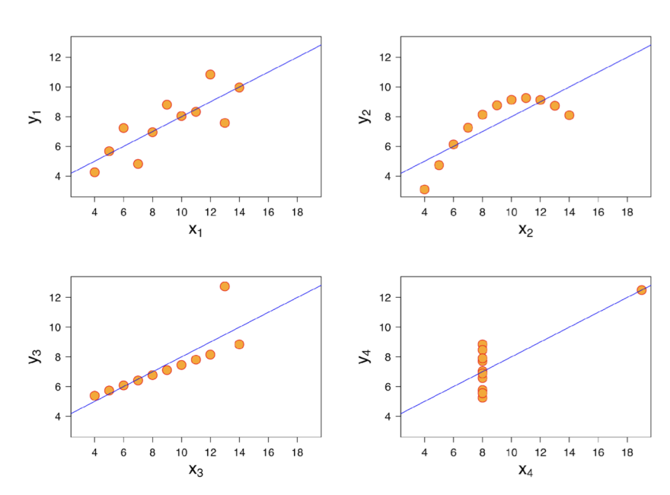
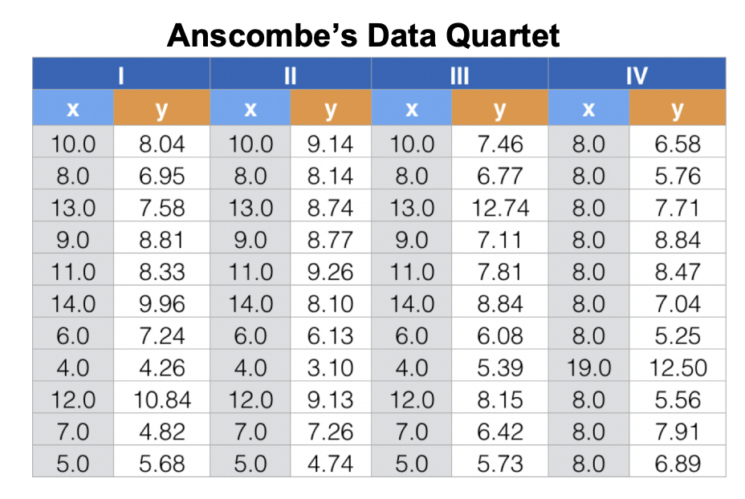
Data Visualization- Why visualization
Visual representations contain much more information than a few summary
If you only view the table below? Can you find the relation between x and y?

Slide 22
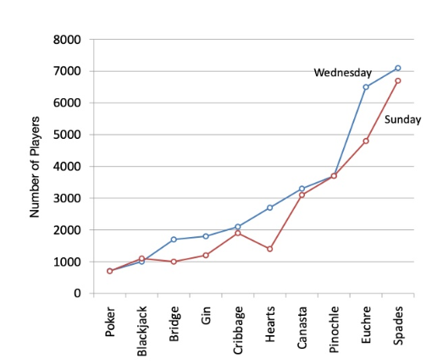
Basic Charts
Line Charts
Suitable Data: Time series data.
Characteristics: Displays trends over time by connecting data points with a line.
Comparison: Unlike scatter plots, line charts emphasize continuity between data points, making them ideal for time-based data.

Slide 23
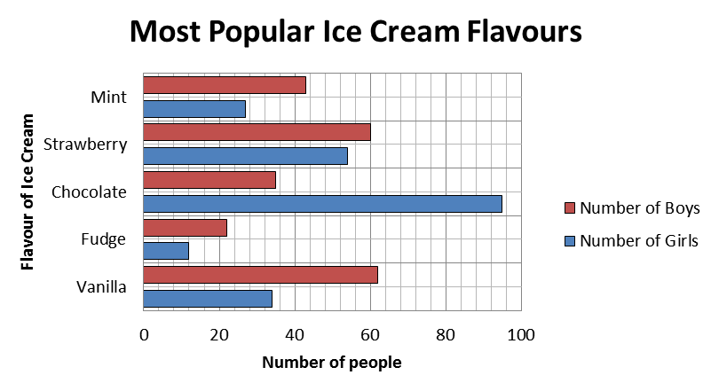
Basic Charts
Bar Charts
Suitable Data: Categorical data.
Characteristics: Compares quantities across categories using rectangular bars. Each bar’s length is proportional to the value it represents.
Comparison: Better than pie charts for showing exact values and making comparisons between categories.

Slide 24
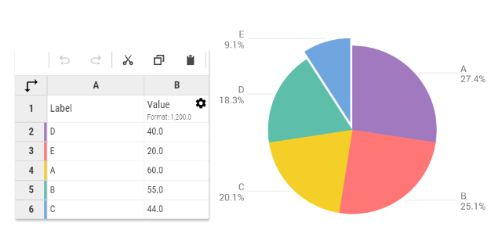
Basic Charts
Pie Charts
Suitable Data: Categorical data (limited categories).
Characteristics: Represents proportions within a whole, with each slice corresponding to a category.
Comparison: While visually appealing, pie charts can be less precise than bar charts, especially with many categories.

Slide 25
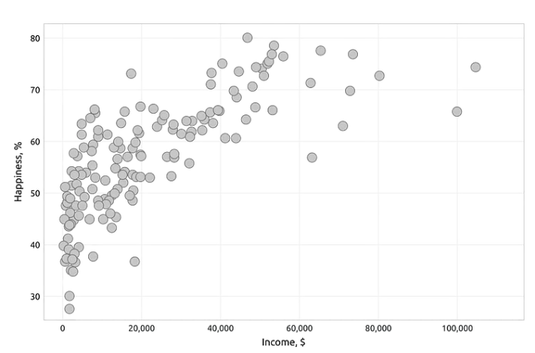
Basic Charts
Scatter Plots
Suitable Data: Two-dimensional numerical data.
Characteristics: Shows the relationship between two variables, with each point representing an observation.
Comparison: Unlike line charts, scatter plots are used to display individual data points, which is useful for identifying correlations.

Slide 26
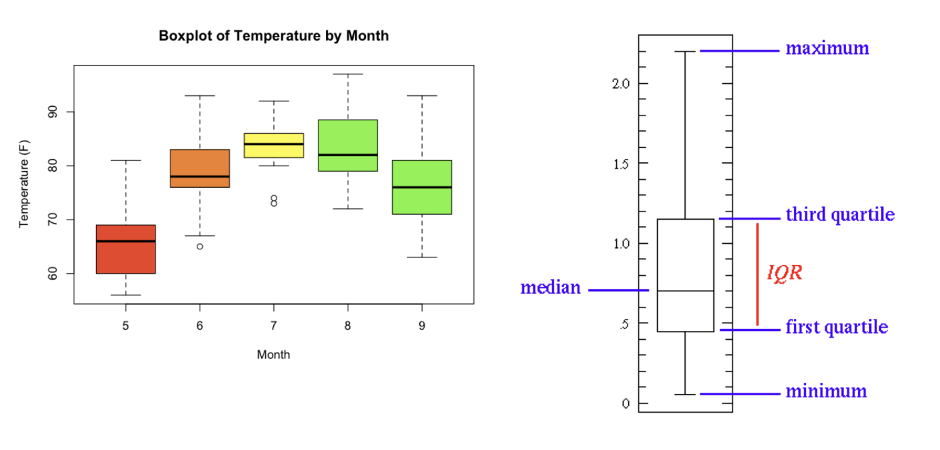
Statistics - Boxplots
Box Plots
Suitable Data: Continuous data.
Characteristics: Summarizes the distribution of a dataset with five key statistics (minimum, first quartile, median, third quartile, and maximum) and highlights outliers.
Comparison: More informative than histograms for identifying data distribution and outliers, but less detailed for showing frequency.

Slide 27
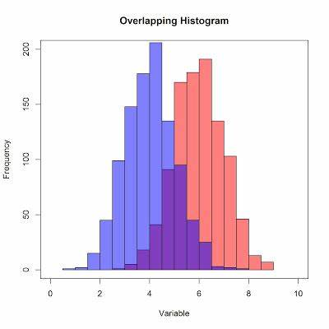
Basic Charts – additional knowledge
Histograms
Suitable Data: Continuous data.
Characteristics: Displays the distribution of a dataset by grouping data into bins and counting the number of observations in each bin.
Comparison: Similar to bar charts, but histograms are used for continuous data while bar charts are for categorical data.

Slide 28
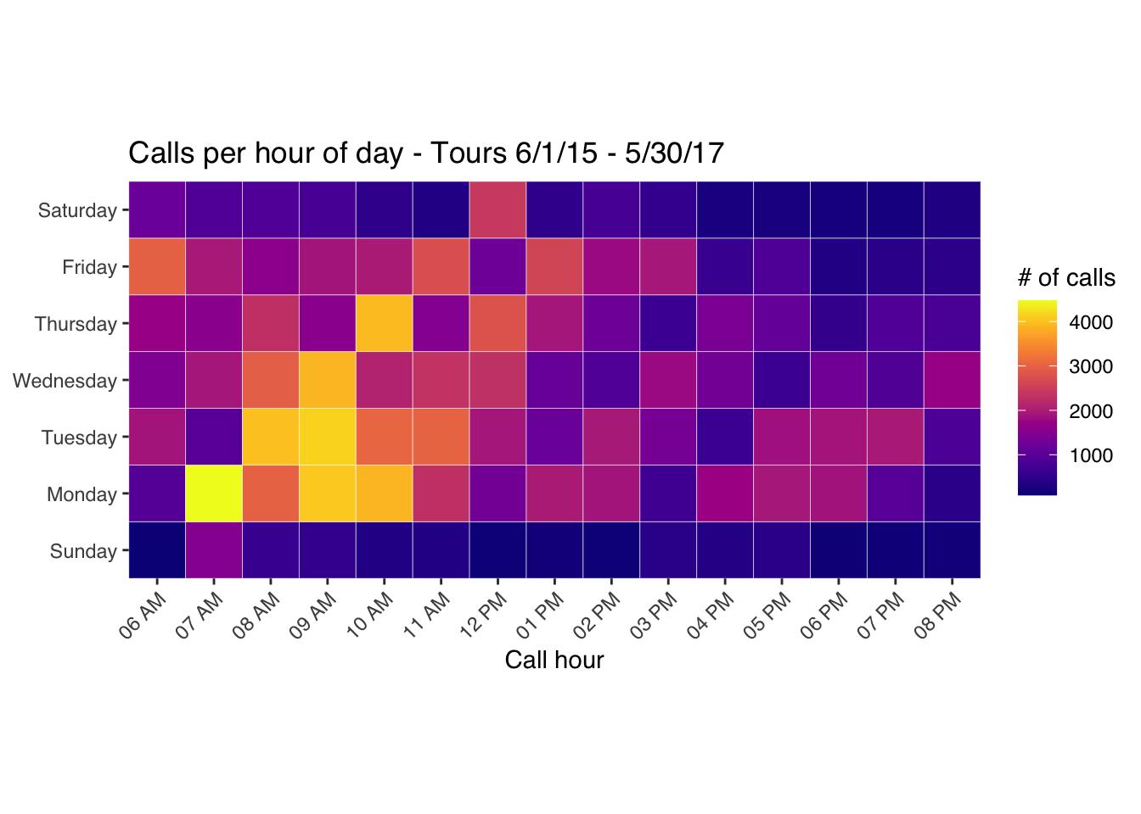
Basic Charts – additional knowledge
Heatmaps
Suitable Data: Matrix data or correlation tables.
Characteristics: Uses color intensity to represent data values, making it easy to see patterns, correlations, and anomalies.
Comparison: Unlike scatter plots, heatmaps are better for visualizing the magnitude of relationships across a matrix of data.

Slide 29
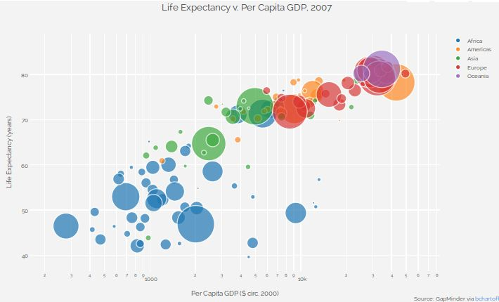
Basic Charts – additional knowledge
Bubble Charts
Suitable Data: Three-dimensional data.
Characteristics: Similar to scatter plots, but each point's size is proportional to a third variable, adding an extra dimension to the data.
Comparison: Unlike scatter plots, bubble charts can visualize three variables at once (x, y, and size), but can become cluttered with many data points.

Slide 30
Have a Break and Move to Lecture 02

